Slide 1
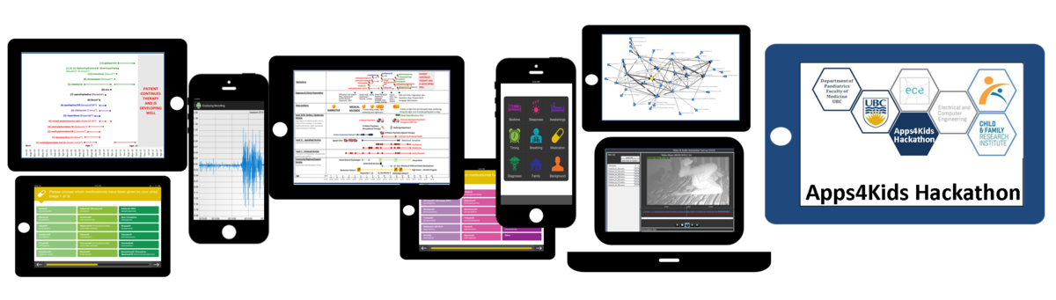


Slide 2

The Team
LED BY:
Dr. Vishal Avinashi
TEAM MEMBERS:
Sohail Vaghari, Dou Mok, Kayla Lee, John Lim, Aditi Chak, Akiff Manji, Lisa Wong, Eric Kim, Yi Tan
Notes:
+ add CFRI logo

Slide 3
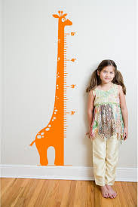
Introduction
Appropriate growth is a measure of good health
This involves serially measuring and tracking:
length/height
head circumference
weight
BMI
http://www.interiorclip.com/interior/961x1440/growth-chart-giraffe-via-etsy-12878.html

Slide 4

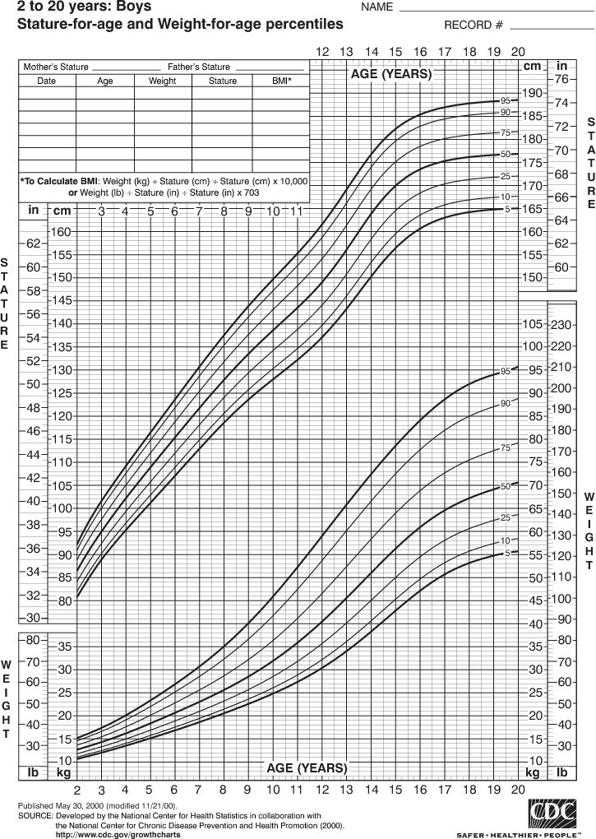
The problem with paper charts…
Issues
Notes:
Current charts are:
hard-to-plot
hard-to-read
does not provide exact percentiles
not available to the families
incomplete
living in different places

Slide 5

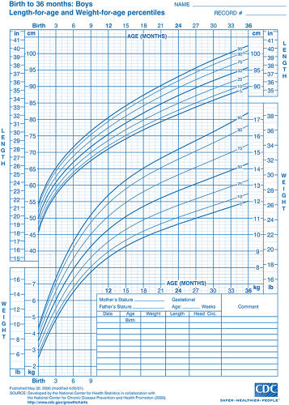
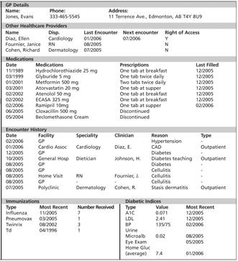
The problem with electronic charts…
Issues
Notes:
Current charts are:
hard-to-plot
hard-to-read
does not provide exact percentiles
not available to the families
incomplete
living in different places

Slide 6
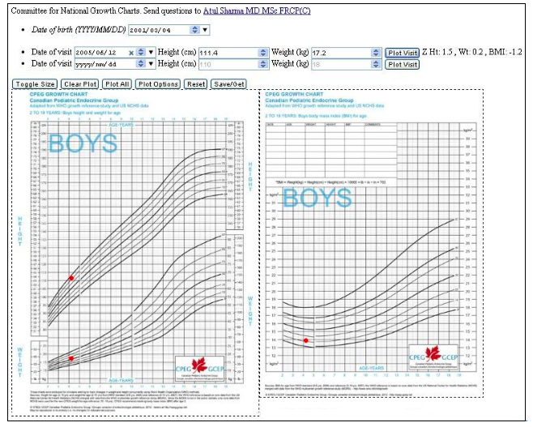

Limitations
BC Children’s Growth Chart Plotter App
Device-exclusive
Notes:
Shortcomings include:
Does not store the information
Can’t access it from certain devices
Cost
Limiting # of children
Advertisements in the way
Not user-friendly
Not share-able
Metrics not right
Doesn’t include WHO Canadian curves

Slide 7
Our Approach
Make it easy for patients to input and share the data
(Include the multiple growth points)
(Ability to switch between curves)
Visually appealing (graphs)
Maintaining accuracy (tables + calculations)
Notes:
Make it easy for patients to input and share the data
(Include the multiple growth points)
(Ability to switch between curves)
Visually appealing (graphs)
Maintaining accuracy (tables + calculations)

Slide 8
Features

Slide 9
3 Easy Steps
INSERT PIC OF STEP 1
INSERT PIC OF STEP 2
INSERT PIC OF STEP 3

Slide 10
Feedback
“ It would be a more convenient way of keeping track of growth compared to the immunization chart”
XX, Parent of
As a parent of a child with a chronic condition, it provides me ease of mind to see my child’s growth and development –
“This is great first step that enables parents to take charge of their children’s health.”

Slide 11
Impact
Having accurate growth data available to families and clinicians
(example)

Slide 12
Future
Implement different growth curves
E.g. Down’s Syndrome
Enable physician log-in to view parent inputted growth points
Email notifications
Parents will automatically get email notifications of when to input growth information
- Compare data with different growth curves (e.g. CPEG, WHO)

Slide 13


